Slide 1
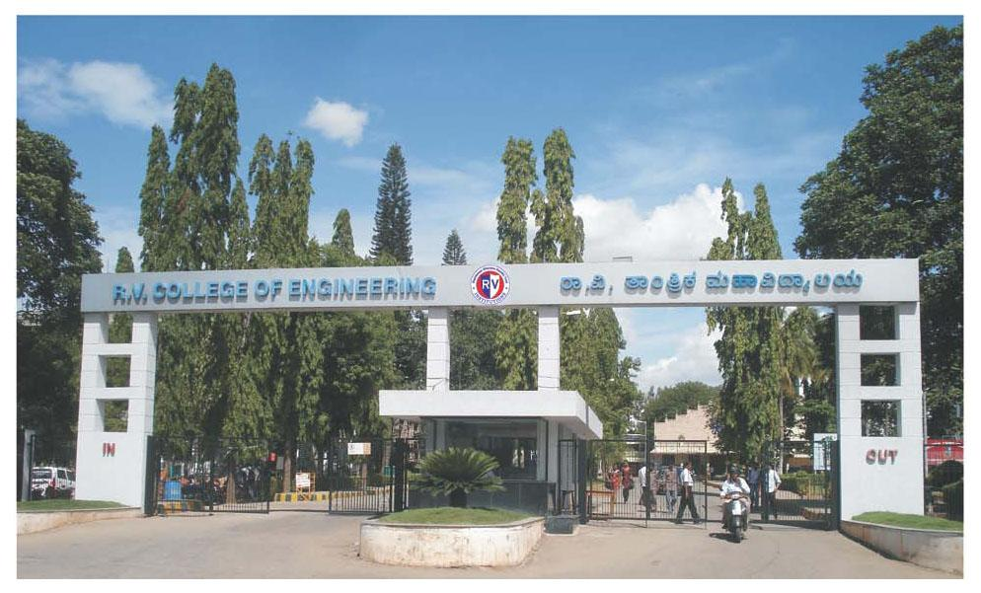
Real-Time Radar Fusion for Human Activity Recognition & Fall Detection Using mmWave Radar using DL
Chirag S Shetty - 1RV23CS077 | Spoorthy S - 1RV23CS305 | Nikhil A E - 1RV23EC089 | Poornachandra B R - 1RV23EC095
Guide : Dr. Rajani Katiyar
Assistant Professor
Electronics and Communication Department

Slide 2
INTRODUCTION
Falls among the elderly frequently go undetected, leading to delayed medical response and serious secondary injury.
Camera-based systems compromise privacy; wearables depend on user compliance -- both are impractical for continuous home monitoring.
Single-sensor radar solutions suffer from occlusions and multipath blind spots, reducing reliability in real-world environments.
This project addresses all three limitations through a dual-radar fusion system that is non-intrusive, placement-agnostic, and self-calibrating requiring no manual setup.
A CNN-Transformer-LSTM model analyses the fused 3D point cloud in real time, with fall alerts delivered instantly to a cloud-hosted caregiver dashboard.

Slide 3
LITERATURE SURVEY
Paper title | Publication / Year | Key contribution | Relevance to the project | Research gap identified
Real-Time Fall Detection With Hybrid CNN-LSTM Using IWR6843AOP FMCW Radar DOI: 10.1109/ACCESS.2025.3605387 ↗ | IEEE Access 2025 | Hybrid 1D CNN-LSTM on IWR6843AOP point cloud data — extracts 9 kinematic features (position, velocity, acceleration per axis), uses multithreaded pipeline for parallel acquisition and inference, achieves 96.7% real-time accuracy with 0.60s average detection delay | Most directly related paper — uses the exact same IWR6843AOP radar hardware as SafeSpace, same elderly care domain, same real-time requirement. Validates CNN-LSTM on IWR6843AOP point cloud as the baseline ML architecture your system builds upon | Runs entirely on local edge device — no cloud pipeline, no MQTT transmission, no remote dashboard. Binary fall/no-fall only — no routine learning, no proactive risk scoring. Single-subject monitoring only (explicitly stated as future work). SafeSpace extends all these limitations
Deep Learning Based Human Activity Recognition in Smart Home ieeexplore ↗ | IEEE Conference 2024 | FCN-LSTM hybrid combining spatial feature extraction and temporal modelling for smart home activity classification | Justifies temporal ML modelling in SafeSpace's pipeline for sequential zone-visit patterns | Requires large labeled training dataset — impractical for new deployments. No unsupervised bootstrapping for cold-start users

Slide 4
LITERATURE SURVEY
Paper title | Publication / Year | Key contribution | Relevance to the project | Research gap identified
Design of Real-Time Monitoring Platform for IoT Based on Cloud Platform ieeexplore.ieee.org/document/9141881 ↗ | IEEE Xplore 2020 | Proposes MQTT + Redis + WebSocket cloud platform for IoT device data collection and real-time chart visualisation using E-Chart | Directly mirrors SafeSpace's architecture: MQTT ingestion → cloud processing → WebSocket push → real-time dashboard. Validates the full pipeline design | No ML processing layer — raw data displayed without intelligence. No anomaly detection or alert logic built on top of the pipeline
A Novel ML Based Fall Detection System using Accelerometer and Gyroscope ieeexplore ↗ | IEEE Xplore 2024 | ANN-based multi-class classifier detecting fall direction (forward/backward/left/right) vs no-fall from 3-axis data | Validates multi-class fall classification — basis for SafeSpace's risk severity scoring | No personalization per individual. Requires physical device on body. Cannot monitor bathroom or private spaces
IoT for Next-Generation Smart Healthcare: A Comprehensive Survey ieeexplore.ieee.org/document/11008531 ↗ | IEEE Journals & Magazine 2024 | Comprehensive survey of IoT + AI + cloud integration for healthcare — covers real-time monitoring, data-driven diagnostics, and remote patient care architectures | Establishes cloud + IoT + AI as the validated modern healthcare monitoring architecture — exactly what SafeSpace implements for elder safety | Surveys generic healthcare IoT. Does not address elder-specific behavioural monitoring or proactive risk prediction from movement pattern data

Slide 5
LITERATURE SURVEY
Paper Title | Publication/Year | Key Contribution | Relevance to the Project | Research Gap
Direction-Independent Human Activity Recognition Using a Distributed MIMO Radar System and Deep Learning | IEEE Access 2023 | Proposes a distributed radar network to recognize human activities (like falling) from any angle, overcoming the blind spots of single-sensor setups | Directly validates our architecture. It proves that placing radars on opposite sides of a room significantly improves the accuracy of detecting complex movements like falls | Focuses heavily on centralized deep learning classification of raw signals, lacking a lightweight methodology for fusing processed, sparse point clouds at the edge before classification
Deep Learning-Based Multiradar Fusion for Robust Real-Time Object Detection | IEEE Xplore 2026 | Demonstrates a framework for fusing data from multiple radars to maintain continuous tracking and overcome line-of-sight occlusions | Highlights the core benefit of our multi-radar setup: maintaining a high Signal-to-Noise Ratio (SNR) and continuous tracking even if furniture blocks one sensor | Optimized for high-speed, 2D planar movement in autonomous driving, missing the specific spatial alignment techniques required for opposite-facing, stationary indoor sensors
PointNet-Transformer Fusion Network for In-Cabin Occupancy Monitoring With mm-Wave Radar | IEEE Conference 2024 | Utilizes an advanced neural network architecture (PointNet + Transformers) specifically designed to process sparse, irregular mmWave point clouds | Provides excellent precedent for how to process and filter the exact type of sparse 3D point cloud data our radars will generate before sending it to the cloud dashboard | Designed for a single, confined perspective (a car interior). It does not address the geometric challenge of merging overlapping, multi-perspective point clouds across a larger room environment
Collision Avoidance in Healthcare Robotics Using mm-Wave Radar Fusion: A Hygienic and Fail-Safe Approach | IEEE Conference 2026 | Integrates mmWave radar in healthcare settings, emphasizing it as a privacy-preserving and fail-safe alternative to optical sensors | It validates mmWave technology for healthcare/fall detection because it preserves patient privacy | Relies on dynamic, moving reference frames (robotics) rather than establishing a fixed, static coordinate transformation matrix between stationary wall mounts
Attention-based Radar and Camera Fusion for Object Detection in Severe Conditions | CISDS Conference 2022 | Fuses radar with camera feeds, using an attention mechanism to rely more heavily on radar when optical visibility drops (e.g., fog, darkness) | Serves as a strong counter-example. We can cite this to explain that while camera fusion is popular, your pure radar approach is necessary for indoor privacy and 24/7 dark-room reliability | Relies on visual anchors (camera data) to guide the fusion process, which cannot be applied to a purely homogeneous, blind (radar-only) coordinate alignment

Slide 6
LITERATURE SURVEY
Paper Title | Publication/Year | Key Contribution | Relevance to the Project | Research Gap
Transformer-Based Radar and Infrared Sensor Fusion for Multi-Target Tracking | IEEE Access 2025 | Combines kinematic data from radar with thermal signatures from infrared (IR) sensors to track multiple targets | Reinforces the elegance and cost-effectiveness of our approach: sticking to a homogenous sensor network (pure mmWave) simplifies the data fusion pipeline | Cross-modal techniques (combining kinematics with thermal data) do not translate to the specific geometric challenge of fusing two identical FMCW spatial datasets
Combined Deep learning architectures using Fusion Rules for Target Recognition in SAR images | IEEE Xplore 2024 | Applies complex fusion rules for target recognition in Synthetic Aperture Radar (SAR) imagery | It acknowledges that while fusion rules exist in macro-radar, they must be adapted for indoor point clouds | Algorithms designed for dense, macro-scale SAR imagery are too computationally heavy and incompatible with the highly sparse, irregular point cloud outputs of indoor FMCW radars
Deep Learning based Multi Sensor Data Fusion for Radar and IFF | IEEE Xplore 2022 | Fuses standard radar tracking with Identification Friend or Foe (IFF) transponders for aviation/defense | Highlights the specific challenge of our project: we must fuse data to detect passive human targets without them wearing any supplementary devices | Relies on cooperative signal tracking. Indoor fall detection systems must fuse data purely based on the physical geometry of uncooperative targets, without any active devices to assist matching
HumanandSmallAnimalDetection Using Multiple Millimeter-Wave Radars and Data Fusion: Enabling Safe Applications | IEEE Conference 2023 | Establish the baseline signal processing pipelines (FMCW chirp generation, FFTs) required to extract range, velocity, and angle data to form a 3D point cloud | Serves as the mathematical and hardware foundation , explaining how the raw analog signals are turned into usable digital data | These baseline methodologies operate in isolation; they do not account for the temporal synchronization needed when two independent hardware clocks capture a simultaneous event

Slide 7
PROBLEM STATEMENT & OBJECTIVES
Problem Statement:
“Existing fall detection systems fail to simultaneously guarantee user privacy, deployment flexibility, multi-person coverage, and reliable detection accuracy in real-world indoor environments , leaving a critical gap in autonomous monitoring for the elderly.”
Objectives:
Develop a self-calibrating dual-radar fusion pipeline that merges two independent 60 GHz FMCW sensors into a single unified 3D point cloud, regardless of sensor placement.
Train a model on the fused point cloud to accurately detect and classify falls across multiple persons in real time.
Deploy a cloud-integrated monitoring dashboard that receives live radar telemetry, triggers instant alerts on fall detection, and logs events for caregiver review.

Slide 8
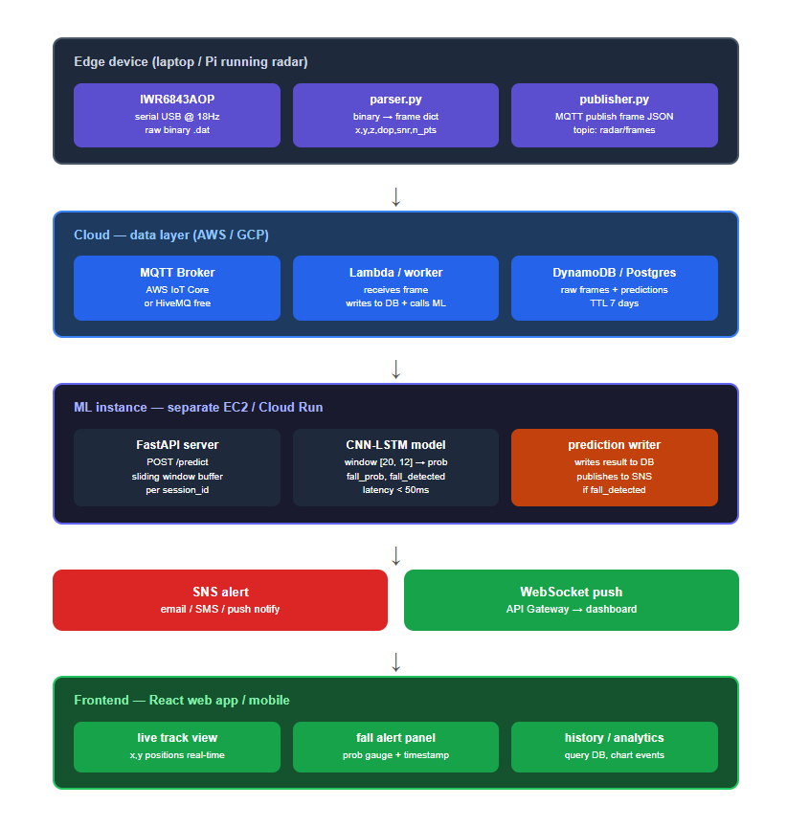
METHODOLOGY

Slide 9
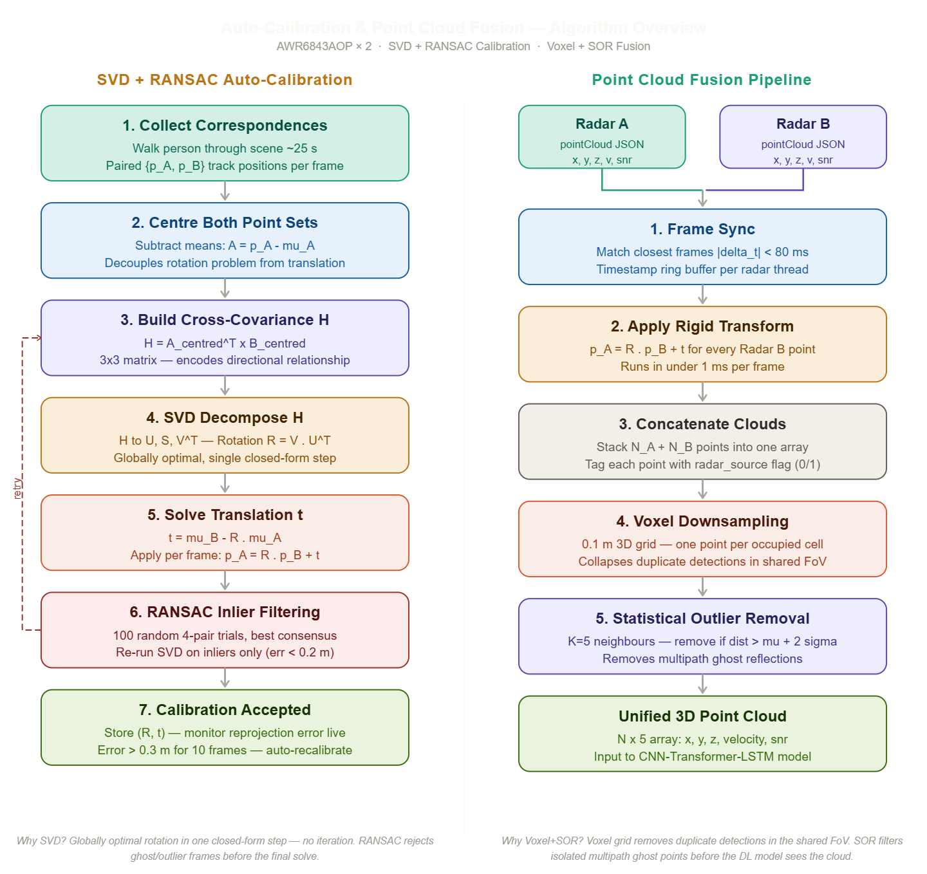
METHODOLOGY

Slide 10
TIMELINE
Duration | Project Phase / Activity
Week 1 – 3 | Literature review, AWR6843AOP firmware configuration, and Raspberry Pi 5 hardware interfacing.
Week 4 – 7 | Frame Synchronisation module, SVD + RANSAC Auto-Calibration loop, and drift detection logic.
Week 8 – 11 | Voxel Downsampling, Statistical Outlier Removal, and full dual-radar fusion pipeline integration and testing.
Week 12 – 14 | model training, evaluation against baselines, and HiveMQ / Render.com cloud integration.
Week 15 – 16 | React Dashboard development, end-to-end system integration testing, fall detection validation, and documentation.

Slide 11
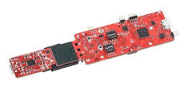
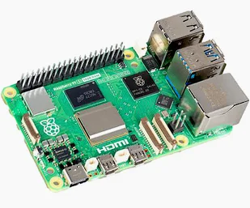
Hardware Layer:
Sensors: 2x Texas Instruments IWR6843AOP (60 GHz FMCW mmWave Radars).
Edge Compute: Raspberry Pi 5 (handles 921,600 baud UART parsing and point cloud fusion).
Software & Algorithmic Layer:
Calibration & Fusion: Singular Value Decomposition (SVD) + RANSAC for automatic geometric alignment; Voxel Grid Downsampling & SOR for noise filtering.
Deep Learning: Hybrid Transformer-CNN-LSTM architecture processing 40-frame sliding windows.
Cloud Backend: FastAPI hosted on a Dockerized Hugging Face Space.
Database: Supabase (PostgreSQL) utilizing WebSocket Realtime channels.
Frontend UI: React, Vite, Recharts (Dynamic Single Page Application).
Tools & Techniques

Slide 12
Work Progress so far
Single-Sensor System Complete: Successfully developed, trained, and deployed the complete end-to-end fall detection pipeline using a single IWR6843AOP radar.
Reliable Fall Detection: The single-radar setup accurately parses the binary TLV data, extracts the spatial features, and successfully detects falls via the Transformer-CNN-LSTM model.
Cloud & Dashboard Deployed: The FastAPI inference server (Hugging Face), Supabase database, and the React frontend dashboard are fully operational and responding to live single-sensor telemetry.
Dual-Sensor Architecture Initiated: Began developing the SVD + RANSAC calibration pipeline to fuse two independent radars; theoretical framework and initial code structure are in place.

Slide 13
Hardware/Software/Simulation complete
demonstration

Slide 14
Accurate Single-Node Inference: The deep learning model successfully distinguishes between normal human movement and sudden fall events using the 40-frame sliding window from the primary radar.
Real-Time UI Visualization: The React dashboard successfully subscribes to Supabase WebSockets, turning the UI red the moment a fall is detected by the edge device with minimal latency.
Dual-Radar Calibration Prototype: Early tests of the SVD algorithms show that homogeneous transformation matrices can be computed to align separate coordinate systems, proving the dual-sensor concept is mathematically viable.
Results

Slide 15
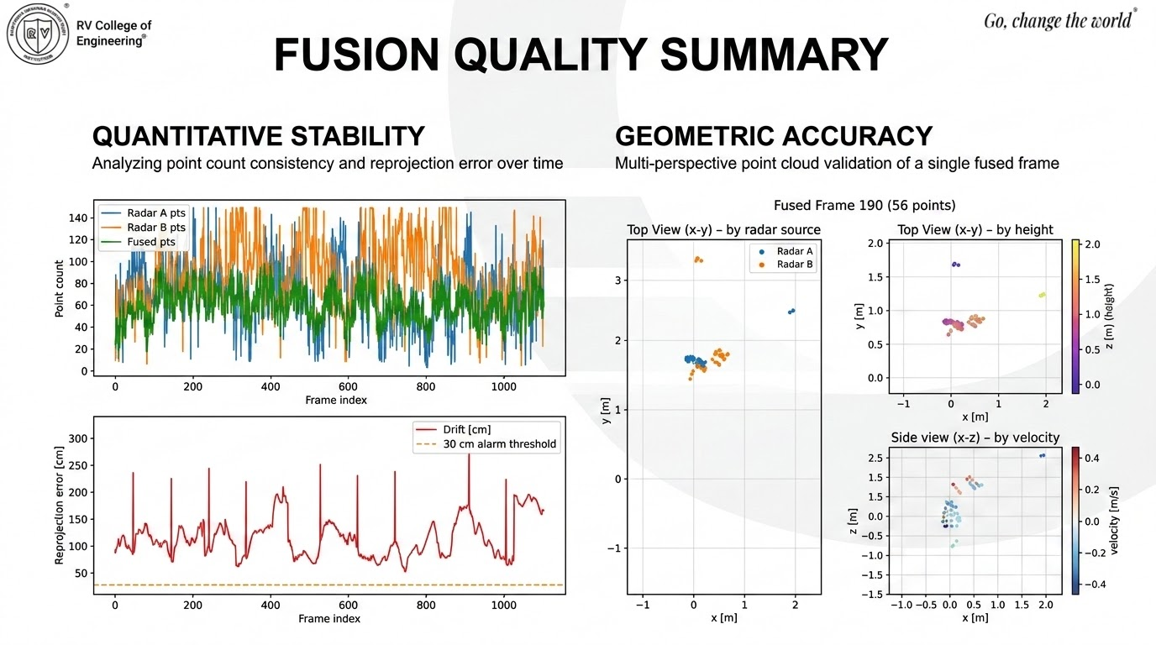

Slide 16
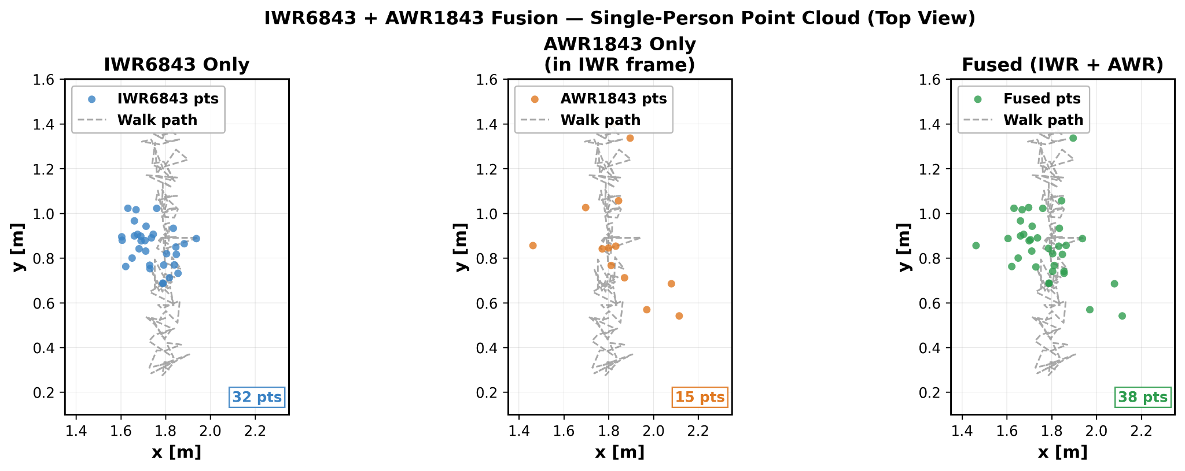
Results

Slide 17
Conclusion
To conclude the project outcome interms of results achieved, limitations
and future work.

Slide 18
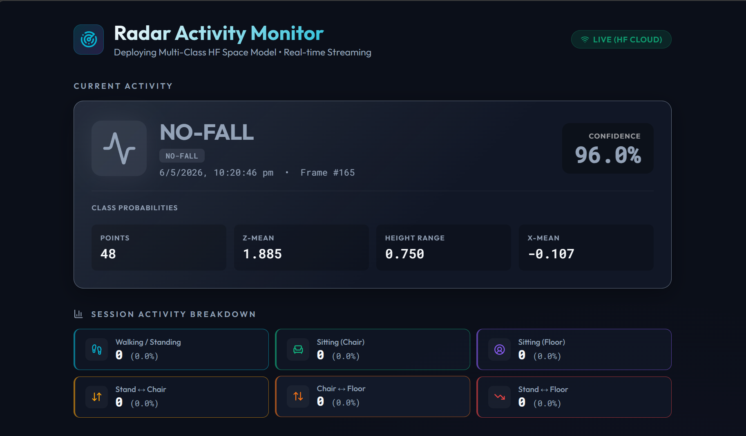
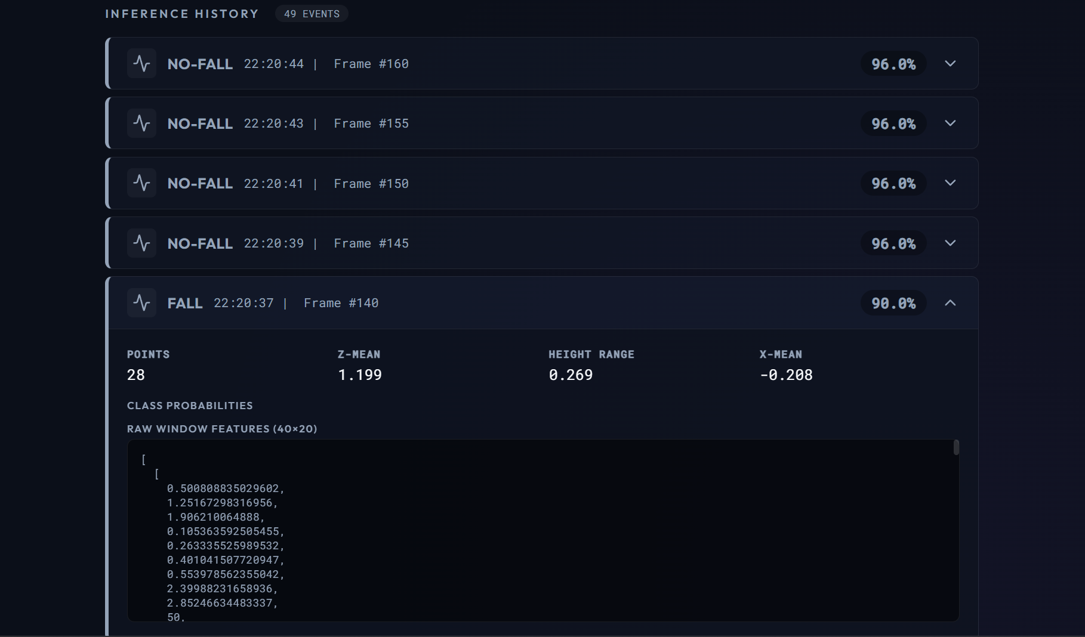

Slide 19
QR Code for Video Demo and PPT

Slide 20
REFERENCES
[1] Y. Cui, F. Liu, X. Jing, and J. Mu, “Integrating sensing and communications for ubiquitous IoT: Applications, trends, and challenges,” IEEE Netw., vol. 35, no. 5, pp. 158–167, Sep./Oct. 2021.
[2] M. Henneberger, “The 10 most exceptional radar applications.” Accessed: Mar. 28, 2025. [Online]. Available: https://radar-blog.innosent.de/en/the-10-most- exceptional-radar-applications/
[3] D. Feng et al., “Deep multi-modal object detection and semantic segmentation for autonomous driving: Datasets, methods, and challenges,” IEEE Trans. Intell. Transp. Syst., vol. 22, no. 3, pp. 1341–1360, Mar. 2021.
[4] Z. Zhou et al., “Enhanced coherent DOA estimation in low SNR environments through contrastive learning,” IEEE Trans. Instrum. Meas., vol. 74, 2025, Art. no. 8504221.
[5] P. Reitz and C. Künzle, “DualRAD60 Dual FMCW Radar Data 60 GHz,” Mar. 2025, doi: 10.5281/zenodo.15063378.
[6] W. Kim, H. Cho, J. Kim, B. Kim, and S. Lee, “YOLO-based simultaneous target detection and classification in automotive FMCW radar systems,” Sensors, vol. 20, no. 10, Jan. 2020, Art. no. 2897.
[7] A. Kosuge, S. Suehiro, M. Hamada, and T. Kuroda, “mmWave-YOLO: A mmWave imaging radar-based real-time multiclass object recognition system for ADAS applications,” IEEE Trans. Instrum. Meas., vol. 71, May 2022, Art. no. 2509810.
[8] R. Nabati and H. Qi, “Radar-camera sensor fusion for joint object detection and distance estimation in autonomous vehicles,” in Proc. 12th Workshop Plan., Perception, Navigation Intell. Veh., 2020, arXiv:2009.08428.
[9] Y. Kim, S. Kim, J. W. Choi, and D. Kum, “CRAFT: Camera-radar 3D object detection with spatio-contextual fusion transformer,” in Proc. 37th AAAI Conf. Artif. Intell. (AAAI’23), Nov. 2022, pp. 1160–1168.
[10] X. Sun, Y. Jiang, H. Qin, J. Li, and Y. Ji, “Camera-radar fusion with radar channel extension and Dual-CBAM-FPN for object detection,” Sensors, vol. 24, no. 16, Jan. 2024, Art. no. 5317.

Slide 21
REFERENCES
[11] F. Fent, A. Palffy, and H. Caesar, “DPFT: Dual perspective fusion transformer for camera-radar-based object detection,” IEEE Trans. Intell. Veh., vol. 10, no. 11, pp. 4929–4941, Nov. 2025.
[12] J.-J. Hwang et al., “CramNet: Camera-radar fusion with ray-constrained cross-attention for robust 3D object detection,” in Proc. 17th Eur. Conf. Comput. Vis., Tel Aviv, Israel, Oct. 2022, pp. 388–405.
[13] S. Woo, J. Park, J.-Y. Lee, and I. S. Kweon, “CBAM: Convolutional block attention module,” in Proc. 15th Eur. Conf. Comput. Vis., Munich, Germany, Jul. 2018, pp. 3–19.
[14] P. Reitz, T. Veihelmann, N. Franchi, and M. Lübke, “Dual radar vision: A feature fusion approach for advanced object detection in IoT radar networks,” Mach. Learn. with Appl., vol. 21, Sep. 2025, Art. no. 100703.
[15] J. H. Lee et al., “Real-time fall detection based on FMCW radar using a deep convolutional neural network,” IEEE Sens. J., vol. 22, no. 10, pp. 9593–9602, May 2022.
[16] Z. Shi, H. Wang, J. Wang, and Z. Chen, “A CNN-LSTM model for human activity recognition using FMCW radar,” in Proc. IEEE Int. Conf. Acoust., Speech Signal Process. (ICASSP), May 2020, pp. 4537–4541.
[17] A. Alshehri, H. Alsubaie, and M. Alshahrani, “Non-intrusive fall detection system for elderly using mmWave radar and transformer-based deep learning,” Sensors, vol. 23, no. 12, Jan. 2023, Art. no. 5567.
[18] S. Zhang et al., “Dual-sensor fusion for robust indoor fall detection: A comprehensive review,” IEEE Trans. Biomed. Eng., vol. 70, no. 8, pp. 2489–2505, Aug. 2023.
[19] D. T. Pham, A. H. K. Kim, and S. Y. Lee, “A comparative study of deep learning models (CNN, LSTM, and CNN-LSTM) for human fall detection,” J. Electr. Eng. Technol., vol. 18, no. 4, pp. 2405–2415, Jul. 2023.
[20] H. Liu, J. Li, and K. Chen, “FMCW radar-based fall detection system using a 3D point cloud and attention mechanism,” in Proc. IEEE Radar Conf., May 2024, pp. 1–6.

Slide 22


